Slide 1
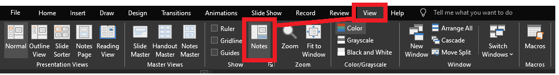
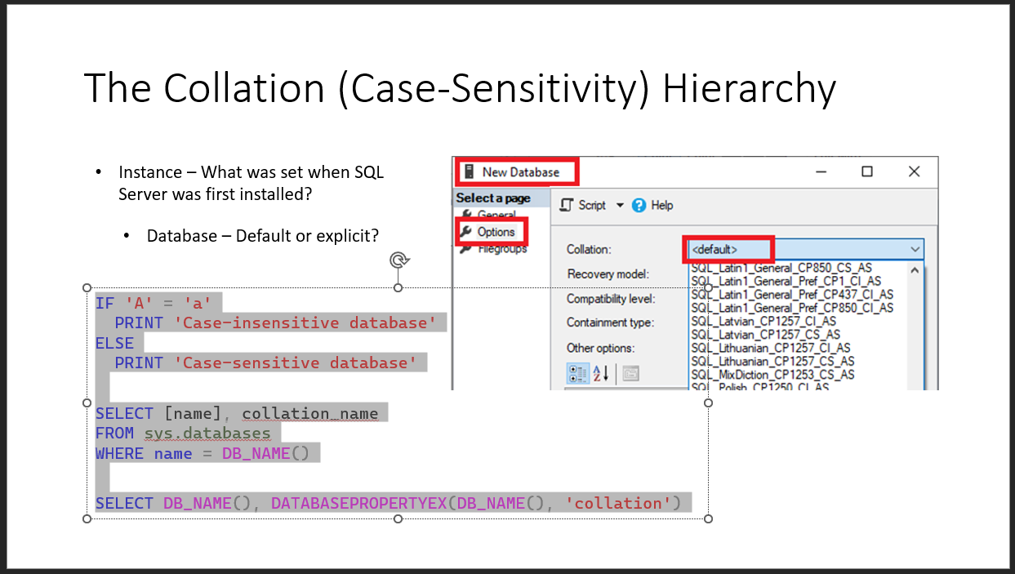
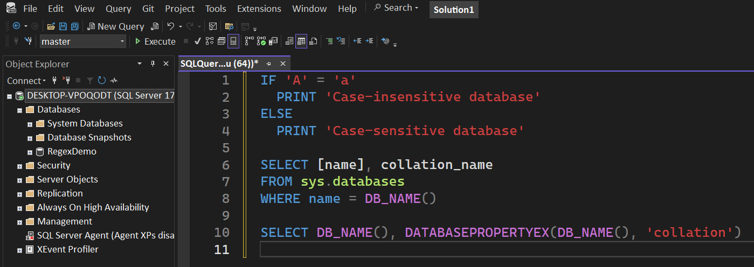
Reviewing after the presentation?
Be sure to enable the Notes for slide-specific content
Slides have working T-SQL that can be copied/pasted into SSMS

Slide 2
The JSON T-SQL Operators
Jeff Foushee
(Title depends on the day)
Humana, Inc.

Slide 3

(With permission from Ephraim Ndoro)
Notes:
My manager tells me to work with Jason, an outsider, who has an import for me.

Slide 4
{
"first_name": "John",
"last_name": "Smith",
"is_alive": true,
"age": 27,
"address": {
"street_address": "21 2nd Street",
"state": "NY",
"postal_code": "10021-3100"
},
"phone_numbers": [
{
"number": "212 555-1234",
"type": "home"
},
{
"number": "646 555-4567",
"type": "office"
}
],
"children": ["Catherine", "Thomas", "Trevor"],
"spouse": null
}
(https://en.wikipedia.org/wiki/JSON)
Notes:
Jason works with semi-structured data. This type doesn’t strictly adhere to a fixed schema or rigid data mode.
JSON represents data in a hierarchical structure using key-value pairs. Objects contain key-value pairs, and arrays can hold multiple values.
This flexibility allows you to nest objects and arrays within each other.

Slide 5




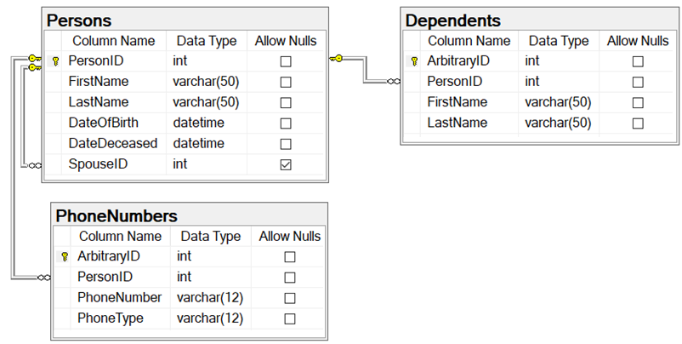


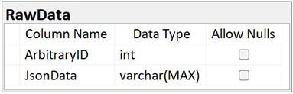



{
"first_name": "John",
"last_name": "Smith",
"is_alive": true,
"age": 27,
"address": {
"street_address": "21 2nd Street",
"state": "NY",
"postal_code": "10021-3100"
},
"phone_numbers": [
{
"number": "212 555-1234",
"type": "home"
},
{
"number": "646 555-4567",
"type": "office"
}
],
"children": ["Catherine", "Thomas"],
"spouse": null
}
Notes:
There may be times were you need to convert one format to the other for import/export purposes.
Maybe you store JSON in the SQL Server in its raw format from an API, and you want to query values from it.
We’ll talk about the operators you need to do that.

Slide 6





Jeff
Foushee
(Title depends on the hour )
Humana, Inc.
Database Administrator
Developer
SQL Saturday Speaker
Blackjack Dealer Currently, I'm working at Humana, a healthcare insurance company headquartered in Louisville, KY.
linkedin.com/in/jeff-foushee/
github.com/jbfoushee/MyPresentations
jefffoushee.com

Slide 7






Agenda
Preparing for JSON (client tools)
Preparing for JSON (table architecture)
Keywords for Inspecting JSON
Keywords for Querying JSON
Keywords for Creating JSON

Slide 8
Preparing for JSON (Client Tools)

Slide 9
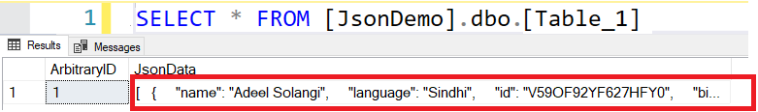
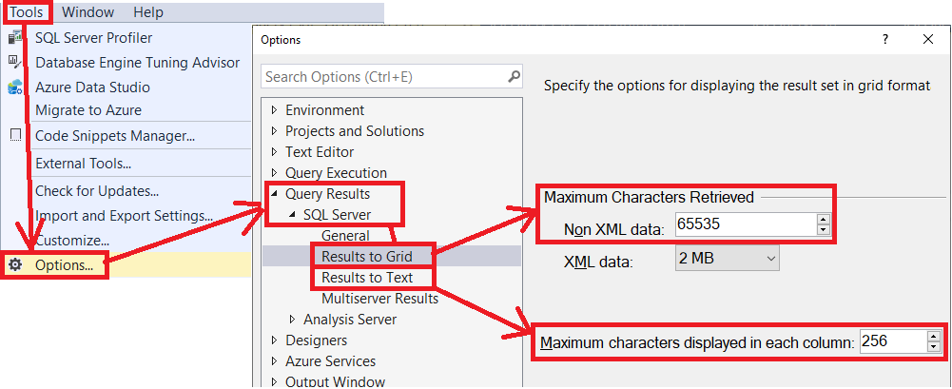
How many characters do you want to see on the screen?
Notes:
SSMS offers an ability to view JSON, and you’ll hit a point where you need to see it for troubleshooting purposes.
When Results As Text, the default is 256 characters.
When Results As Grid, the default is 65 thousand plus characters.
Both can be updated to a little over 2 million.
Even so, both formats run the risk of results being truncated

Slide 10
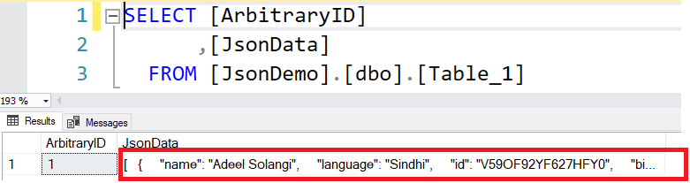


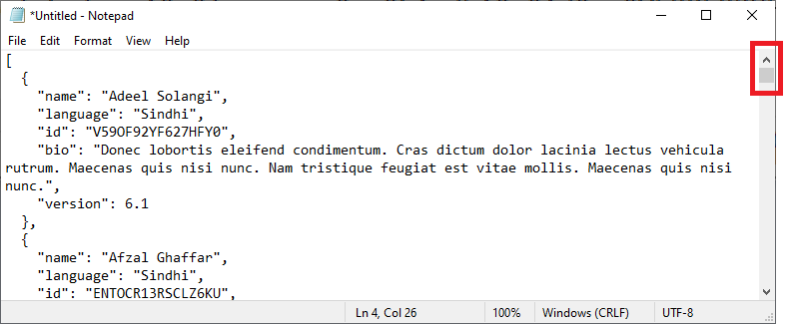
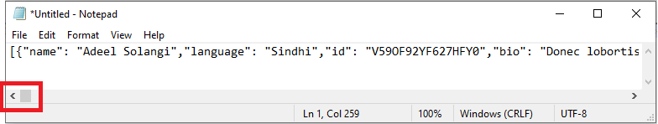
Notes:
I can copy this data from SSMS, and paste into Notepad.
But depending how it was initially stored, I’m not in control if I want to scroll left-to-right across I-64, or up-and-down across I-65.
(I have an extra demo where you can review this yourself. See the ‘Pretty Print’ sql file.)

Slide 11
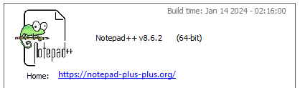
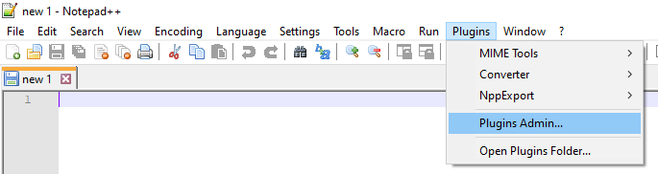
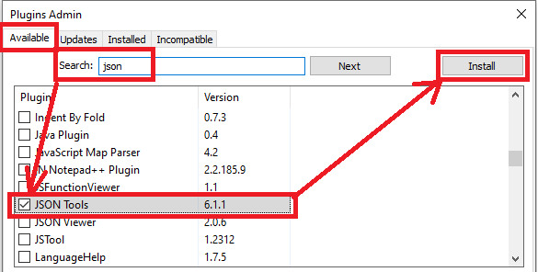
Notes:
Notepad++ is a free tool that has a JSON plug-in

Slide 12
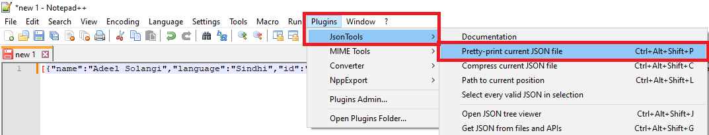
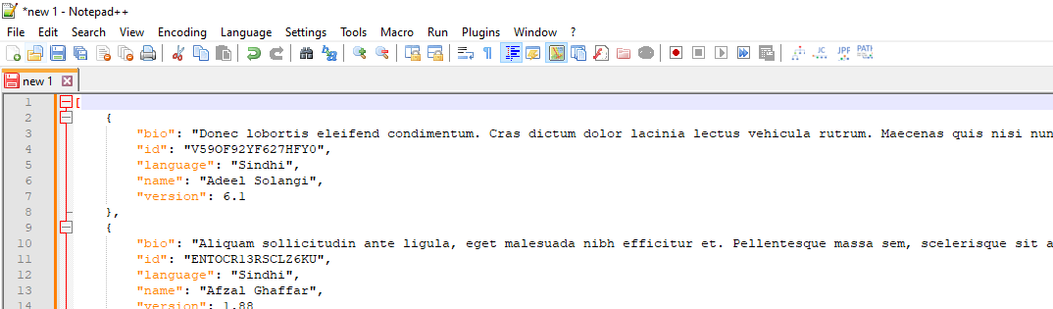
Notes:
It allows you to “pretty-print” or indent your JSON, and the option is compress or minify your JSON.

Slide 13
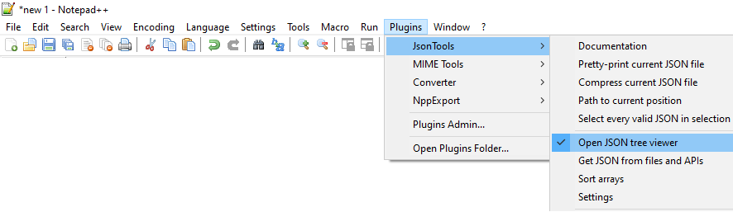
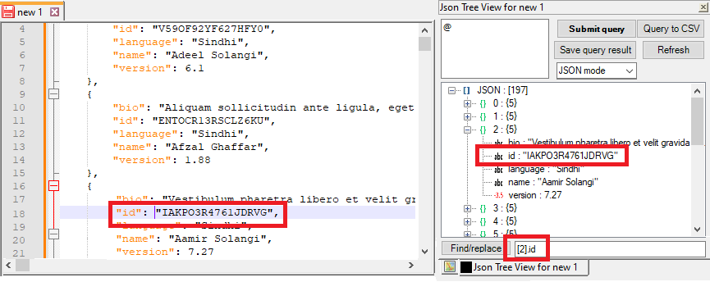
Notes:
The JSON tree viewer helps you navigate the JSON document object model, locating values and reflecting the path in JSON notation

Slide 14
Preparing for JSON (Table Architecture)

Slide 15
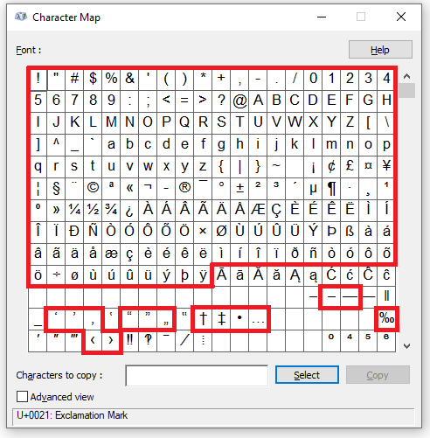

varchar(n|MAX) :
(n up to 8000)
(MAX up to 2 billion)
The storage size is #(chars) + 2 bytes.
nvarchar(n|MAX) : (n up to 4000)
(MAX up to 1 billion)
The storage size is larger per character:
[#(chars) * 2] + 2 bytes.
char(n) :
The storage size is n bytes.
nchar(n) :
The storage size is 2n bytes.
1 byte
Refresher:
FF (hex) = 255 (decimal) = 1111 1111 (binary)
If you only need the characters in red, you can use varchar
Notes:
I want to store JSON in SQL Server. Do I use varchar or nvarchar?
If your characters cannot be represented by the ones in red, you need nvarchar.
Notice the selection of a variety of foreign accented letters, and grammar-corrected punctuation.
You may also need to consider if have legal reasons to capture “exactly” what the user entered.

Slide 16
The JSON datatype
CREATE TABLE [dbo].[Table_1](
[ID] [int] IDENTITY(1,1) NOT NULL,
[MyColumn1] [json] NOT NULL
) ON [PRIMARY]
GO
SQL Server 2025+
Azure SQL Database
Azure SQL Managed Instance
Notes:
What does the JSON datatype afford us?
Supports documents up to 2GB (in binary format)
More efficient reads, as the document is already parsed
More efficient writes, as the query can update individual values without accessing the entire document
More efficient storage, optimized for compression

Slide 17
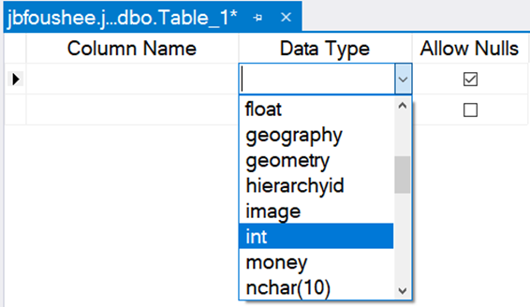
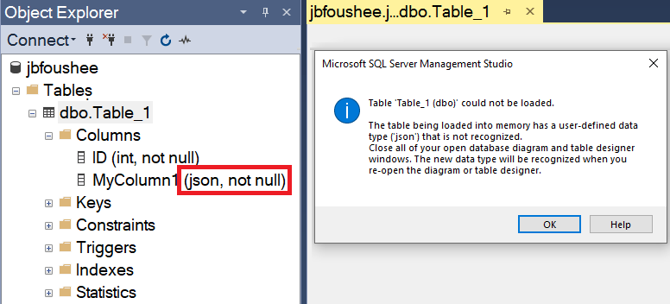
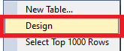
SSMS is not JSON-type friendly (yet)
Would be here
alphabetically
Unable to create a column of
datatype JSON
“The table has a datatype that is not recognized”
Unable to use designer upon a table containing JSON-datatype column
Notes:
However, any table that involves a column of datatype JSON must be manipulated by TSQL. You cannot use the SSMS table designer.

Slide 18
Datatype summary
Feature | JSON (SQL 2025+) | NVARCHAR(MAX) | VARCHAR(MAX)
Encoding | UTF-8 (binary format) | UTF-16 (Unicode) | ASCII (1 byte per character)
Storage Efficiency | Highly Compressed | Larger due to Unicode | Smaller than NVARCHAR
Performance | Faster read/writes | Slower due to parsing | Slightly faster than NVARCHAR

Slide 19
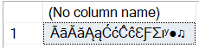
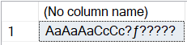
Shortcut for CONVERT(nvarchar, text)
DECLARE @_text nvarchar(20) = N'ĀāĂăĄąĆćĈĉƐƑƩɪʸ●♫'
SELECT CONVERT(nvarchar(20), @_text)
SELECT CONVERT(varchar(20), @_text)
Notes:
If you choose your datatype incorrectly, you could face issues of character demotion, substitution, or loss.

Slide 20
{
"first_name": "John",
"last_name": "Smith",
"is_alive": true,
"age": 27,
"address": {
"street_address": "21 2nd Street",
"state": "NY",
"postal_code": "10021-3100"
},
"phone_numbers": [
{
"number": "212 555-1234",
"type": "home"
},
{
"number": "646 555-4567",
"type": "office"
}
],
"children": ["Catherine", "Thomas", "Trevor"],
"spouse": null
}
(https://en.wikipedia.org/wiki/JSON)
Notes:
Let’s look at some rules of JSON formatting

Slide 21
{
"first_name": "John",
"last_name": "Smith",
"is_alive": true,
"age": 27,
"address": {
"street_address": "21 2nd Street",
"state": "NY",
"postal_code": "10021-3100"
},
"phone_numbers": [
{
"number": "212 555-1234",
"type": "home"
},
{
"number": "646 555-4567",
"type": "office"
}
],
"children": ["Catherine", "Thomas", "Trevor"],
"spouse": null
}
$.address.state
Notes:
Whatever character starts must have a finishing character. Since these are curly braces, this is a JSON object. There is only one entry.
Our path will start at the root, denoted by a $-character.

Slide 22
[{
"first_name": "John",
"last_name": "Smith",
"is_alive": true,
"age": 27,
"address": {
"street_address": "21 2nd Street",
"state": "NY",
"postal_code": "10021-3100"
},
"phone_numbers": [
{
"number": "212 555-1234",
"type": "home"
},
{
"number": "646 555-4567",
"type": "office"
}
],
"children": ["Catherine", "Thomas", "Trevor"],
"spouse": null
}]
$[0].address.state
Notes:
These outside brackets are boxed, meaning that this is an array. This array happens to contain one item: an object.
Arrays in JSON are zero-based, just like in JavaScript.
APIs may return a JSON resultset as an array even when one item was returned.

Slide 23
{ "data":
[{
"first_name": "John",
"last_name": "Smith",
"is_alive": true,
"age": 27,
"address": {
"street_address": "21 2nd Street",
"state": "NY",
"postal_code": "10021-3100"
},
"phone_numbers": [
{
"number": "212 555-1234",
"type": "home"
},
{
"number": "646 555-4567",
"type": "office"
}
],
"children": ["Catherine", "Thomas", "Trevor"],
"spouse": null
}]
}
$.data[0].address.state
Notes:
Furthermore, an API may prefix the array with a property name, even something as trivial as “value”, “data” or “response”.
Notice this pushes all the data down one level lower by indention.

Slide 24
{
"first_name": "John",
"last_name": "Smith",
"is_alive": true,
"age": 27,
"address": {
"street_address": "21 2nd Street",
"state": "NY",
"postal_code": "10021-3100"
},
"phone_numbers": [
{
"number": "212 555-1234",
"type": "home"
},
{
"number": "646 555-4567",
"type": "office"
}
],
"children": ["Catherine", "Thomas", "Trevor"],
"spouse": null
}
Datatypes
Strings: Enclosed in double-quotes
Numbers: Not enclosed in quotes
Boolean: Lowercase, unquoted
Null: Lowercase, unquoted
…

Slide 25
{
"first_name": "John",
"last_name": "Smith",
"is_alive": true,
"age": 27,
"address": {
"street_address": "21 2nd Street",
"state": "NY",
"postal_code": "10021-3100"
},
"phone_numbers": [
{
"number": "212 555-1234",
"type": "home"
},
{
"number": "646 555-4567",
"type": "office"
}
],
"children": ["Catherine", "Thomas", "Trevor"],
"spouse": null
}
Properties (keys) must be enclosed in quotes
No restrictions on property naming:
- uniqueness*
- special characters (almost all of them)
- blanks
Notes:
While, yes, I could name all my properties the same name, our TSQL JSON operators will only pick up the first one it comes across.
Clearly, this is not a beneficial practice. Nor is naming the properties with names that I can’t easily describe or type.
(I have an extra demo to demonstrate this. Look for the file titled “Property Naming.”)

Slide 26
{
"first_name": "John",
"last_name": "Smith",
"is_alive": true,
"age": 27,
"address": {
"street_address": "21 2nd Street",
"state": "NY",
"postal_code": "10021-3100"
},
"phone_numbers": [
{
"number": "212 555-1234",
"type": "home"
},
{
"number": "646 555-4567",
"type": "office"
}
],
"children": ["Catherine", "Thomas", "Trevor"],
"spouse": null
}
Values are paired to the right of the property

Slide 27
{
"first_name": "John",
"last_name": "Smith",
"is_alive": true,
"age": 27,
"address": {
"street_address": "21 2nd Street",
"state": "NY",
"postal_code": "10021-3100"
},
"phone_numbers": [
{
"number": "212 555-1234",
"type": "home"
},
{
"number": "646 555-4567",
"type": "office"
}
],
"children": ["Catherine", "Thomas", "Trevor"],
"spouse": null
}
Values are paired to the right of the property
They can be “scalar” (number or string).

Slide 28
{
"first_name": "John",
"last_name": "Smith",
"is_alive": true,
"age": 27,
"address": {
"street_address": "21 2nd Street",
"state": "NY",
"postal_code": "10021-3100"
},
"phone_numbers": [
{
"number": "212 555-1234",
"type": "home"
},
{
"number": "646 555-4567",
"type": "office"
}
],
"children": ["Catherine", "Thomas", "Trevor"],
"spouse": null
}
Values are paired to the right of the property
They can be Boolean or null
(not considered scalar).
Notes:
“null” is lowercase. Anything else is considered text.

Slide 29
{
"first_name": "John",
"last_name": "Smith",
"is_alive": true,
"age": 27,
"address": {
"street_address": "21 2nd Street",
"state": "NY",
"postal_code": "10021-3100"
},
"phone_numbers": [
{
"number": "212 555-1234",
"type": "home"
},
{
"number": "646 555-4567",
"type": "office"
}
],
"children": ["Catherine", "Thomas", "Trevor"],
"spouse": null
}
Values are paired to the right of the property
Datatypes
Strings: Enclosed in double-quotes
Numbers: Not enclosed in quotes
Boolean: Lowercase, unquoted
Null: Lowercase, unquoted
Object {}: Nestable, logical grouping

Slide 30
{
"first_name": "John",
"last_name": "Smith",
"is_alive": true,
"age": 27,
"address": {
"street_address": "21 2nd Street",
"state": "NY",
"postal_code": "10021-3100"
},
"phone_numbers": [
{
"number": "212 555-1234",
"type": "home"
},
{
"number": "646 555-4567",
"type": "office"
}
],
"children": ["Catherine", "Thomas", "Trevor"],
"spouse": null
}
Values are paired to the right of the property.
Datatypes
Strings: Enclosed in double-quotes
Numbers: Not enclosed in quotes
Boolean: Lowercase, unquoted
Null: Lowercase, unquoted
Object {}: Nestable, logical grouping
Array []: Nestable, unordered list of values
(Array of JSON objects)
(Array of strings)
Notes:
Notice how I say unordered, yet the example shows an alphabetical list of children.
You cannot expect the data to return this way every time, nor can you make decisions of order in this manner.
I have personally experienced APIs returning arrays in random order.
If order is important, change children from an array of strings to an array of JSON objects. The object would then include properties “name” and “age” for example.
Datatypes do not have to match in an array, and array-members can include other arrays or objects.

Slide 31
Inspecting JSON
T-SQL keywords | SELECT / WHERE | FROM / APPLY / JOIN | (Other)
ISJSON() | þ
JSON_PATH_EXISTS() | þ
JSON_CONTAINS() | þ

Slide 32

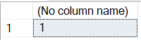
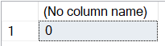
ISJSON(what)
Tests for a valid JSON object or array
DECLARE @_json char(2) = '{}'
SELECT ISJSON(@_json)
DECLARE @_json char(2) = '[]'
SELECT ISJSON(@_json)
DECLARE @_json char(2) = ''
--DECLARE @_json char(2) = '['
--DECLARE @_json char(2) = '.'
SELECT ISJSON(@_json)
SQL Server 2016+
Azure SQL Database
Azure SQL Managed Instance
Azure Synapse Analytics
SQL analytics endpoint in Microsoft Fabric
Warehouse in Microsoft Fabric
Notes:
The smallest JSON you can make is 2 characters: curly brackets or square brackets.

Slide 33

Notes:
There are enough rules that you could make a game show out of it, but thankfully we can let SQL Server do the heavy thinking for us

Slide 34
ISJSON(what)
Tests for a valid JSON object or array
1. SELECT ISJSON('[]') -- 1
2. SELECT ISJSON('{}') -- 1
3. SELECT ISJSON('[{}]') -- 1
4. SELECT ISJSON('{[]}') -- 0
5. SELECT ISJSON('{"key":[]}') -- 1
6. SELECT ISJSON('[{"key":{}}]') -- 1
7. SELECT ISJSON('[1,2]') -- 1
8. SELECT ISJSON('"key":[1,2]') -- 0
9. SELECT ISJSON('{[1,2]}') -- 0
10. SELECT ISJSON('{},{}') -- 0
11. SELECT ISJSON('[{},{}]') -- 1
12. SELECT ISJSON('{[],[]}') -- 0
13. SELECT ISJSON(NULL) -- NULL
14. SELECT ISJSON('NULL') -- 0
15. SELECT ISJSON('null') -- 0
Property names require outer JSON objects to contain them (8 → 5)
A property name is optional for the root array (1, 3). All arrays inside an object require a property name (4 →
1, 5). Conversely, a property name requires an outer object (8 → 7, 5).
There can only be one JSON object, unless enclosed in an array (10 → 11)
NULLs are not JSON
SQL Server 2016+
Azure SQL Database
Azure SQL Managed Instance
Azure Synapse Analytics
SQL analytics endpoint in Microsoft Fabric
Warehouse in Microsoft Fabric
Notes:
In testing various values, some JSON formatting rules have appeared

Slide 35

ISJSON(what [, json_type] = (OBJECT|ARRAY)] )
Tests for a valid JSON value. This can be a JSON object, array, number, string or
one of the three literal values of (false, true, null)
JSON_type value | Description
ARRAY | Tests for a valid JSON array
OBJECT | Tests for a valid JSON object
SCALAR | Tests for a valid JSON scalar – number or string
VALUE | Tests for anything that qualifies to be a value of a key/value pair: a JSON object, JSON array, scalar (number or string) or one of three literal values in {false, true, null}
(lowercase!)
SQL Server 2022+
Azure SQL Database
Azure SQL Managed Instance
SQL analytics endpoint in Microsoft Fabric
Warehouse in Microsoft Fabric
Notes:
SQL Server 2022 has improved ISJSON with a second parameter

Slide 36
ISJSON(what [, json_type] = (OBJECT|ARRAY)] )
SELECT ISJSON( | , VALUE) | , SCALAR) | , OBJECT) | , ARRAY) | )
NULL | NULL | NULL | NULL | NULL | NULL
'NULL' | 0 | 0 | 0 | 0 | 0
'null' | 1 | 0 | 0 | 0 | 0
'a' | 0 | 0 | 0 | 0 | 0
'"a"' | 1 | 1 | 0 | 0 | 0
'2' | 1 | 1 | 0 | 0 | 0
'"2"' | 1 | 1 | 0 | 0 | 0
'false' | 1 | 0 | 0 | 0 | 0
'"false"' | 1 | 1 | 0 | 0 | 0
'[]' | 1 | 0 | 0 | 1 | 1
'[1,2,4]' | 1 | 0 | 0 | 1 | 1
'{}' | 1 | 0 | 1 | 0 | 1
'{"key":"value"}' | 1 | 0 | 1 | 0 | 1
(any malformed JSON) | 0 | 0 | 0 | 0 | 0
XOR =
Notes:
Things to note:
TSQL NULL is not JSON
JSON null is lowercase, without quotes, and is not a scalar value
Text needs to be in quotes
Numerics do not need quotes, but putting them in quotes treats them as strings
false is a keyword, but “false” is a string
The default for ISJSON is an XOR of OBJECT|ARRAY

Slide 37
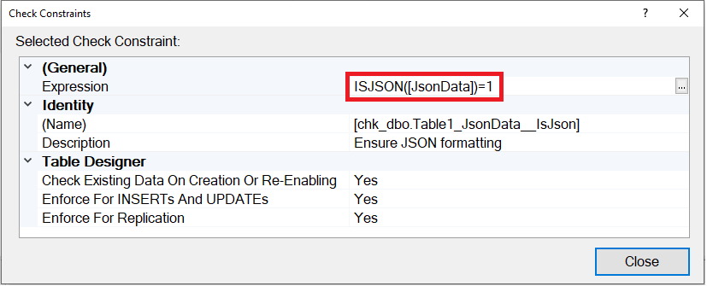
ALTER TABLE [dbo].[Table1] WITH CHECK
ADD CONSTRAINT [chk_dbo.Table1_JsonData__IsJson]
CHECK ( ISJSON([JsonData]) = 1 )
Notes:
We can add a column-level constraint to a table, where the text must agree to the ISJSON function before it can settle in the table data.
However, if you add data in a batch, all the rows’ values for that column must agree or they all get rejected as a unit-of-work.
This constraint is not necessary for a column of datatype JSON, as it will automatically check for formatting.

Slide 38
JSON_PATH_EXISTS(valid_json, path)
Returns confirmation if a path exists to an array or value inside the valid json
DECLARE @_json varchar(8000) = '
{
"name":"Jeff Foushee"
, "parents":[{"name":"Mom"},{"name":"Dad"}]
}'
SELECT JSON_PATH_EXISTS(@_json, '$') -- 1
SELECT JSON_PATH_EXISTS(@_json, '$.parents') -- 1
SELECT JSON_PATH_EXISTS(@_json, '$.parents[0]') -- 1
SELECT JSON_PATH_EXISTS(@_json, '$.parents[0].name') -- 1
SELECT JSON_PATH_EXISTS(@_json, '$.parents[10]') -- 0
SELECT JSON_PATH_EXISTS(@_json, '$.name') -- 1
SELECT JSON_PATH_EXISTS(@_json, '$."bogus-field"') -- 0
[10] -- 0
"bogus-field" -- 0
SQL Server 2022+
Azure SQL Database
Azure SQL Managed Instance
Notes:
Note that the SQL engine is smart enough to know that there is no extra positions of parents beyond 0 and 1.
The “bogus-field” property needs double-quotes because the hyphen is a special character.
Any of the properties can be double-quoted, but they are not necessary when special characters are absent.

Slide 39
JSON_PATH_EXISTS(valid_json, path)
Returns confirmation if a path exists inside the valid JSON
DECLARE @_json varchar(8000) = '{' -- or other malformed JSON
SELECT JSON_PATH_EXISTS(@_json, '$') -- 0
SELECT JSON_PATH_EXISTS(@_json, '$.parents') -- 0
SELECT JSON_PATH_EXISTS(@_json, '$.name') -- 0
SELECT JSON_PATH_EXISTS(@_json, '$."bogus-field"') -- 0
Notes:
If root (“$”) doesn’t even exist, you have bad JSON

Slide 40
JSON_PATH_EXISTS(valid_json, path)
Returns confirmation if a path exists inside the valid JSON
DECLARE @_json varchar(8000) = '
{
"name":"Jeff Foushee"
, "parents":[{"name":"Mom"},{"name":"Dad"}]
}'
IF ISJSON(@_json) = 1
BEGIN
IF JSON_PATH_EXISTS(@_json, '$."karate-belt_color"')
BEGIN
PRINT 'Stay away!'
END
END
ELSE
PRINT 'Not JSON-formatted'
Notes:
I’d probably use ISJSON to test for valid JSON, and JSON_PATH_EXISTS for optional properties such as “feature-flag”

Slide 41
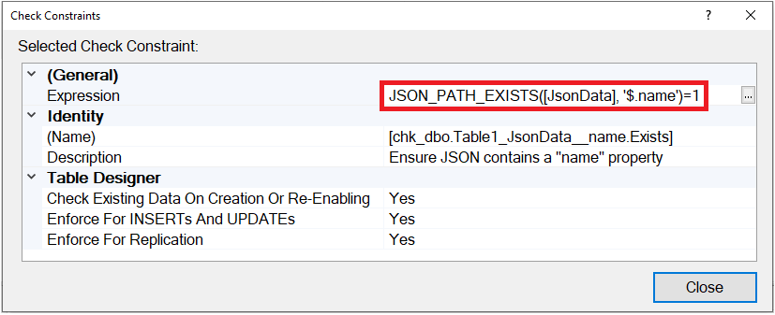
ALTER TABLE [dbo].[Table1] WITH CHECK
ADD CONSTRAINT [chk_dbo.Table1_JsonData__name.Exists]
CHECK ( JSON_PATH_EXISTS([JsonData], '$.name') = 1 )
Notes:
We can add a column-level constraint to a table, where the JSON text must contain a certain key before it can settle in the table data.
However, if you add data in a batch, all the rows’ values for that column must agree or they all get rejected as a unit-of-work.

Slide 42
JSON_CONTAINS(valid_json, value, path)
Returns confirmation if a key/value combination exists within the JSON document
New for SQL Server 2025!
DECLARE @_json json = '
{
"name":"Jeff Foushee"
, "parents":[{"name":"Mom"},{"name":"Dad"}]
, "json_expert":false
}'
SELECT JSON_CONTAINS(@_json, 'Jeff Foushee', '$.name') -- 1
SELECT JSON_CONTAINS(@_json, 'Bob', '$.name') -- 0
SELECT JSON_CONTAINS(@_json, 1, '$.a') -- NULL
SELECT JSON_CONTAINS(@_json, 'Mom', '$.parents[1].name') -- 0
SELECT JSON_CONTAINS(@_json, 'Dad', '$.parents[*].name') -- 1
SELECT JSON_CONTAINS(@_json, 'false', '$.json_expert') -- 0
SELECT JSON_CONTAINS(@_json, 0, '$.json_expert') -- 0
SELECT JSON_CONTAINS(@_json, CAST(0 AS bit), '$.json_expert') -- 1
Notes:
Note the availability of the *-wildcard, where if the value exists ANYWHERE in the key, a true is returned.

Slide 43
Querying JSON
T-SQL keywords | SELECT / WHERE | FROM / APPLY / JOIN | (Other)
JSON_QUERY() | þ
JSON_VALUE() | þ
OPENJSON() |  | þ

Slide 44
JSON_QUERY(valid_json [, path = '$'])
Returns a well-formatted JSON array or object from the original JSON , but not scalar/Boolean values
DECLARE @_json varchar(8000) = '
{
"name":"Jeff Foushee"
, "parents":[{"name":"Mom"},{"name":"Dad"}]
, "json_expert":false
}'
SELECT JSON_QUERY(@_json, '$') -- {entire contents of @_json}
SELECT JSON_QUERY(@_json, '$.parents') -- [{"name":"Mom"},{"name":"Dad"}]
SELECT JSON_QUERY(@_json, '$.name') -- NULL
SELECT JSON_QUERY(@_json, '$.parents[0]') -- {"name":"Mom"}
SELECT JSON_QUERY(@_json, '$.parents[0].name')-- NULL
SELECT JSON_QUERY(@_json, '$.parents[1].name')-- NULL
SELECT JSON_QUERY(@_json, '$.json_expert') -- NULL
SQL Server 2016+
Azure SQL Database
Azure SQL Managed Instance
Azure Synapse Analytics
Notes:
If invalid JSON is passed to JSON_QUERY, an error is returned.

Slide 45
JSON_QUERY(valid_json [, path = '$'])
Returns a well-formatted JSON array or object from the original JSON , but not scalar/Boolean values
New for SQL Server 2025!
DECLARE @_json varchar(8000) = '
{
"name":"Jeff Foushee"
, "parents":[{"name":"Mom"},{"name":"Dad"}]
, "json_expert":false
}'
SELECT JSON_QUERY(@_json, '$.parents') -- [{"name":"Mom"},{"name":"Dad"}]
SELECT JSON_QUERY(@_json, '$.parents' WITH ARRAY WRAPPER)
-- [[{"name":"Mom"},{"name":"Dad"}]]
SELECT JSON_QUERY(@_json, '$.parents[0]') -- {"name":"Mom"}
SELECT JSON_QUERY(@_json, '$.parents[0]' WITH ARRAY WRAPPER)
-- [{"name":"Mom"}]
SQL Server 2025+
Notes:
If invalid JSON is passed to JSON_QUERY, an error is returned.

Slide 46
JSON_VALUE(valid_json, path)
Returns a scalar/boolean value of a key (as string) within JSON, but not a JSON object/array
DECLARE @_json varchar(8000) = '
{
"name":"Jeff Foushee"
, "parents":[{"name":"Mom"},{"name":"Dad"}]
, "json_expert":false
}'
SELECT JSON_VALUE(@_json, '$') -- NULL
SELECT JSON_VALUE(@_json, '$.parents') -- NULL
SELECT JSON_VALUE(@_json, '$.name') -- Jeff Foushee
SELECT JSON_VALUE(@_json, '$.parents[0]') -- NULL
SELECT JSON_VALUE(@_json, '$.parents[0].name') -- Mom
SELECT JSON_VALUE(@_json, '$.parents[1].name') -- Dad
SELECT JSON_VALUE(@_json, '$.json_expert') -- false
SQL Server 2016+
Azure SQL Database
Azure SQL Managed Instance
Azure Synapse Analytics
Notes:
If invalid JSON is passed to JSON_VALUE, an error is returned.

Slide 47
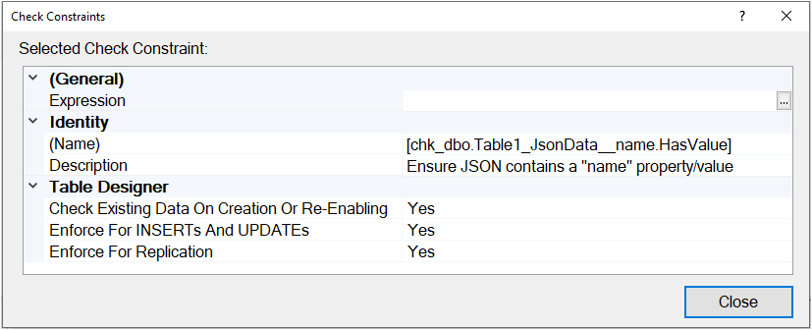
ALTER TABLE [dbo].[Table_1] WITH CHECK ADD
CONSTRAINT [chk_dbo.Table1_JsonData__name.HasValue]
CHECK (
TRIM(JSON_VALUE([JsonData],'$.name')) != ''
AND JSON_VALUE([JsonData],'$.name') IS NOT NULL
)
Notes:
We can add a column-level constraint to a table, where the JSON text must contain a certain key and NON-NULL value before it can settle in the table data.
However, if you add data in a batch, all the rows’ values for that column must agree or they all get rejected as a unit-of-work.

Slide 48

Demo time…
JSON Operators
as Check Constraints

Slide 49
JSON_QUERY() vs JSON_VALUE()
DECLARE @_json varchar(8000) = '
{
"name":"Jeff Foushee"
, "parents":[{"name":"Mom"},{"name":"Dad"}]
, "json_expert":false
}'
JSON_PATH_EXISTS()
1
1
1
1
1
1
SQL Statement | JSON_QUERY() | JSON_VALUE()
SELECT <func>(@_json,'$') | {entire contents of @_json} | NULL
SELECT <func>(@_json,'$.parents') | [{"name":"Mom"},{"name":"Dad"}] | NULL
SELECT <func>(@_json,'$.name') | NULL | Jeff Foushee
SELECT <func>(@_json,'$.parents[0]') | [{"name":"Mom"}] | NULL
SELECT <func>(@_json,'$.parents[0].name') | NULL | Mom
SELECT <func>(@_json,'$.parents[1].name') | NULL | Dad
Another
XOR?
Notes:
It is quite unfortunate that these two functions do not intersect, but determine whether you get results or not.
Even I will mix them up so don’t get frustrated.
You absolutely need sample data to know which function will acquire it.

Slide 50
Demo (on your own time)
● JSON_QUERY() vs JSON_VALUE()

Slide 51

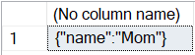
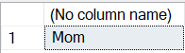
DECLARE @_json varchar(8000) = '
{
"name":"Jeff Foushee"
, "parents":[{"name":"Mom"},{"name":"Dad"}]
, "json_expert":false
}'
SELECT JSON_QUERY(
@_json,'$.parents[0]')
SELECT JSON_VALUE(
@_json,'$.parents[0].name')
SELECT
JSON_VALUE(
JSON_QUERY(
JSON_QUERY(@_json,'$.parents')
, '$[0]')
, '$.name')
SELECT
JSON_QUERY(
JSON_QUERY(@_json,'$.parents')
, '$[0]')
Notes:
The root ($) moves perspective as you navigate with JSON_QUERY

Slide 52
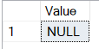

The “path” argument always starts with “$”, right?
DECLARE @_json varchar(8000) = '
{
"name":"Jeff Foushee"
, "parents":[{"name":"Mom"},{"name":"Dad"}]
, "json_expert":false
}'
SELECT
JSON_VALUE(@_json, 'lax $.blah')
AS [Value]
SELECT
JSON_VALUE(@_json, 'strict $.blah')
AS [Value]
Msg 13608, Level 16, State 1
Property cannot be found on the
specified JSON path.
Notes:
You can prefix the $ with keywords lax and strict.
Lax (default) prevents errors and results with NULL when no value is found at the JSON path given.
Strict throws errors only when no value is found at the JSON path given.
“Lax” and “strict” can applied to any JSON operator that uses the ‘$’ notation.
Fun fact: JSON_PATH_EXISTS will accept the lax/strict keywords, but ultimately ignores them…. Providing only a yes/no answer if the path exists.

Slide 53
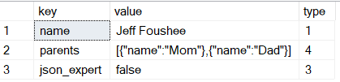
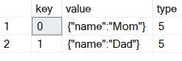
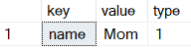
OPENJSON(valid_json [, path = '$'])
Interprets the JSON object into a relational view, using a DataFrame
DECLARE @_json varchar(8000) = '
{
"name":"Jeff Foushee"
, "parents":[{"name":"Mom"},{"name":"Dad"}]
, "json_expert":false
}'
SELECT * FROM OPENJSON(@_json)
SELECT * FROM
OPENJSON(@_json, '$.parents')
type | description
0 | null
1 | string
2 | number
3 | boolean
4 | JSON array
5 | JSON object
SQL Server 2016+
Azure SQL Database
Azure SQL Managed Instance
Azure Synapse Analytics
SQL analytics endpoint in Microsoft Fabric
Warehouse in Microsoft Fabric
SELECT * FROM
OPENJSON(@_json, '$.parents[0]')
Notes:
The dataset returned by OPENJSON is statement-scoped. Unless you send it to a table, it is lost at the next statement.
Notice the types returned. Perhaps you could build a hierarchical loop and process these rows differently based on the value of type?

Slide 54
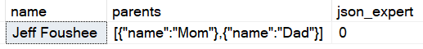
OPENJSON(valid_json [, path = '$']) WITH()
Interprets the JSON object into a relational view, using a DataFrame
DECLARE @_json varchar(8000) = '
{
"name":"Jeff Foushee"
, "parents":[{"name":"Mom"},{"name":"Dad"}]
, "json_expert":false
}'
SELECT * FROM OPENJSON(@_json)
Unpivot
Pivot
SELECT t.*
FROM OPENJSON(@_json, '$')
WITH ([name] nvarchar(255) 'strict $.name' -- lax/strict optional
, [parents] nvarchar(MAX) AS JSON – 'AS JSON' because array/object
, json_expert bit -- path not necessary because of matching key
) t
Notes:
OPENJSON also supports a WITH clause to pre-define the table signature it will return, mapped to the paths within the JSON
If the key value is an object or array, use the AS JSON phrase, rather than map a path.
Using the WITH() phrase is the difference between getting results pivoted or unpivoted.
Check out my other presentation “The TSQL PIVOT Operators” sometime at Github, SQL Saturday, or YouTube.

Slide 55

OPENJSON and the JSON datatype
Odd “I.T.” #1
DECLARE @_json json = '
{
"name":"Jeff Foushee"
, "parents":[{"name":"Mom"},{"name":"Dad"}]
, "json_expert":false
}'
SELECT * FROM OPENJSON(@_json)
OpenJson support not yet supported for JSON native data type.
SELECT *
FROM OPENJSON
(Convert(nvarchar(max),@_json))
Notes:
Of all the JSON operators, OPENJSON is the only one that currently does not work with the JSON datatype.
But this is an easy fix: We just convert the json text into an nvarchar.
Hopefully this will be addressed soon by Microsoft.

Slide 56
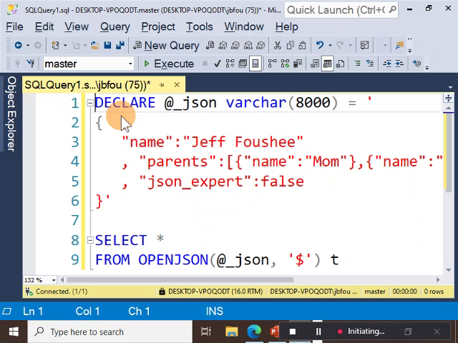
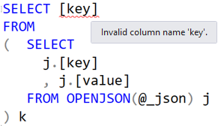
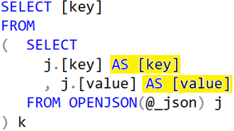
OPENJSON and IntelliSense
Odd “I.T.” #2
IntelliSense does not enumerate columns returned by OPENJSON, even those explicitly defined using WITH().
This can further lead to IntelliSense warning you a column does not exist further up the query.
Fix: Re-introduce the column name
Notes:
IntelliSense does not work with OPENJSON, so you might think you’re using it wrong.
So remember: you define the columns using the WITH() phrase,
or you have the default “key,” “value” and “type” columns if you avoid the WITH() phrase.
If you reach an “invalid column key” error, you can fix this by re-aliasing the column name as itself.

Slide 57
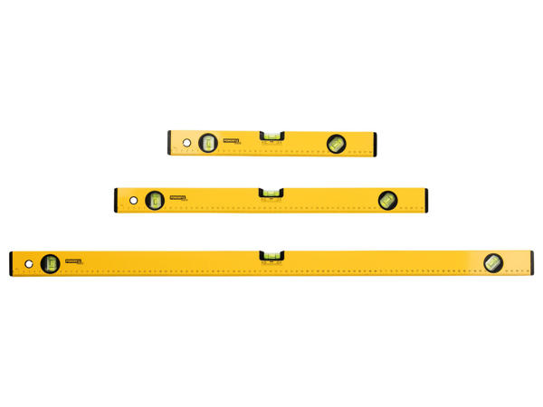
Time for a level-set….
(level set)

Slide 58
CROSS APPLY
Notes:
Let’s talk about CROSS APPLY

Slide 59
CROSS JOIN
Not a JSON function. Makes a cartesian product of the rows between two tables
SELECT *
FROM dbo.Table_1
CROSS JOIN dbo.Table_2
Table_1
Column1 | Column2
1_1_1 | 1_1_2
1_2_1 | 1_2_2
Column1 | Column2 | ColumnX | ColumnY | ColumnZ
1_1_1 | 1_1_2 | 2_1_X | 2_1_Y | 2_1_Z
1_1_1 | 1_1_2 | 2_2_X | 2_2_Y | 2_2_Z
1_2_1 | 1_2_2 | 2_1_X | 2_1_Y | 2_1_Z
1_2_1 | 1_2_2 | 2_2_X | 2_2_Y | 2_2_Z
Table_2
ColumnX | ColumnY | ColumnZ
2_1_X | 2_1_Y | 2_1_Z
2_2_X | 2_2_Y | 2_2_Z
(ANSI-standard SQL)

Slide 60
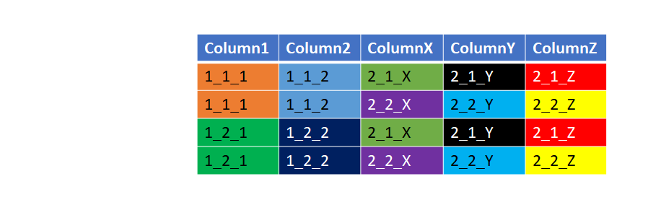
CROSS JOIN
Not a JSON function. Makes a cartesian product of the rows between two tables
Table_1
Table_2
Column1 | Column2
1_1_1 | 1_1_2
1_2_1 | 1_2_2
ColumnX | ColumnY | ColumnZ
2_1_X | 2_1_Y | 2_1_Z
2_2_X | 2_2_Y | 2_2_Z
Isolate the first row of Table_1 versus Table_2
Column1 | Column2 | ColumnX | ColumnY | ColumnZ
1_1_1 | 1_1_2 | 2_1_X | 2_1_Y | 2_1_Z
1_1_1 | 1_1_2 | 2_2_X | 2_2_Y | 2_2_Z
Isolate the second row of Table_1 versus Table_2
Column1 | Column2 | ColumnX | ColumnY | ColumnZ
1_2_1 | 1_2_2 | 2_1_X | 2_1_Y | 2_1_Z
1_2_1 | 1_2_2 | 2_2_X | 2_2_Y | 2_2_Z
Notes:
We can take away from the CROSS JOIN that “for each” row in Table1, we get rows of Table2

Slide 61
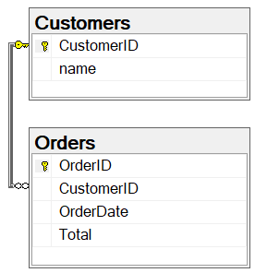
CROSS APPLY
Not a JSON function. Acquires a subset of data for each row found by the outer query. Behaves like an INNER JOIN: if no subset if found, the outer row disappears from the result set.
SELECT c.*, o.*
FROM Customers c
INNER JOIN Orders o
ON c.CustomerID = o.CustomerID
INNER JOIN
( SELECT CustomerID
, MAX(OrderDate) AS OrderDate
FROM Orders
GROUP BY CustomerID
) latest1
ON o.CustomerID = latest1.CustomerID
AND o.OrderDate = latest1.OrderDate
SELECT c.*, ca.*
FROM Customers c
CROSS APPLY
( SELECT TOP 1 *
FROM Orders o
WHERE o.CustomerId = c.CustomerId
ORDER BY OrderDate DESC
) ca
SQL Server 2005+
Azure SQL Database
Azure SQL Managed Instance
Azure Synapse Analytics
SQL analytics endpoint in Microsoft Fabric
Warehouse in Microsoft Fabric
Notes:
Cross apply, also known as a “lateral join”, simplifies the statement.

Slide 62
CROSS APPLY
Not a JSON function. Acquires a subset of data for each row found by the outer query. Behaves like an INNER JOIN: if no subset if found, the outer row disappears from the result set.
SELECT c.*, o.*
FROM Customers c
INNER JOIN Orders o
ON c.CustomerId = o.CustomerId
INNER JOIN
(
SELECT CustomerId, OrderDate
FROM
(
SELECT ROW_NUMBER()
OVER(PARTITION BY CustomerID
ORDER BY OrderDate DESC)
AS [Rank]
, CustomerId
, OrderDate
FROM Orders
) latest
WHERE [Rank] <= 2
) latest2
ON o.CustomerID = latest2.CustomerId
AND o.OrderDate = latest2.OrderDate
SELECT c.*, ca.*
FROM Customers c
CROSS APPLY
( SELECT TOP 2 *
FROM Orders o
WHERE o.CustomerId = c.CustomerId
ORDER BY OrderDate DESC
) ca
Notes:
The statement is a lot harder with TOP 2.
Note also how the execution plans show that the CROSS JOIN is more performant than the INNER JOIN method
(I did not add primary keys and indexes to this simple example.
The results change slightly if you design it properly, but Query 2 remains more performant.)

Slide 63
OUTER APPLY
Not a JSON function. Acquires a subset of data for each row found by the outer query. Behaves like an LEFT JOIN: if no subset if found, the outer row appears in the result set anyway.
SELECT c.*, o.*
FROM Customers c
LEFT JOIN Orders o
ON c.CustomerId = o.CustomerId
LEFT JOIN
(
SELECT CustomerId, OrderDate
FROM
(
SELECT ROW_NUMBER()
OVER(PARTITION BY CustomerID
ORDER BY OrderDate DESC)
AS [Rank]
, CustomerId
, OrderDate
FROM Orders
) latest
WHERE [Rank] <= 2
) latest2
ON o.CustomerID = latest2.CustomerId
AND o.OrderDate = latest2.OrderDate
SELECT c.*, ca.*
FROM Customers c
OUTER APPLY
( SELECT TOP 2 *
FROM Orders o
WHERE o.CustomerId = c.CustomerId
ORDER BY OrderDate DESC
) ca
SQL Server 2005+
Azure SQL Database
Azure SQL Managed Instance
Azure Synapse Analytics
SQL analytics endpoint in Microsoft Fabric
Warehouse in Microsoft Fabric

Slide 64


Why am I showing you this?
SELECT * FROM OPENJSON(@_json)
SELECT OPENJSON(json_col) FROM ...
SELECT ... FROM/JOIN
OPENJSON(localhost.Database.dbo.Table1.json_col)
Notes:
It’s one thing to work with variables, it’s another to work directly with JSON data stored in the table.
You might be tempted to use OPENJSON in the SELECT clause, but remember it belongs in the FROM clause.
The FROM clause requires a table as a datasource, not a column

Slide 65
Demo time…
OPENJSON + CROSS APPLY

Slide 66
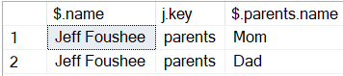
OPENJSON + CROSS APPLY (vs. JSON object)
DECLARE @_json varchar(8000) = '
{
"name":"Jeff Foushee"
, "parents":[{"name":"Mom"},{"name":"Dad"}]
, "json_expert":false
}'
SELECT JSON_VALUE(@_json, '$.name') AS [$.name]
, j.[key] AS [j.key]
, JSON_VALUE(k.[value], '$.name') AS [$.parents.name]
FROM OPENJSON(@_json, '$') j
CROSS APPLY OPENJSON(j.[value], '$') k
WHERE j.[key] = 'parents'
Notes:
The CROSS APPLY should form a dependency (a join) to the OPENJSON source above.

Slide 67
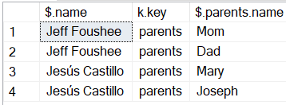
OPENJSON + CROSS APPLY (vs. JSON array)
DECLARE @_json varchar(8000) = '
[{
"name":"Jeff Foushee"
, "parents":[{"name":"Mom"},{"name":"Dad"}]
, "json_expert":false
},
{
"name":"Jesús Castillo"
, "parents":[{"name":"Mary"},{"name":"Joseph"}]
, "json_expert":true
}]'
SELECT JSON_VALUE(j.[value],'$.name') AS [$.name]
, k.[key] AS [k.key]
, JSON_VALUE(l.[value],'$.name') AS [$.parents.name]
FROM OPENJSON(@_json, '$') j
CROSS APPLY OPENJSON(j.[value], '$') k
CROSS APPLY OPENJSON(k.[value], '$') l
WHERE k.[key] = 'parents'
Notes:
I could not write this query using CROSS APPLY OPENJSON(@_json) on each line.
The WHERE clause is important because issuing JSON_VALUE against a non-object will result in a parse error similar to
“JSON text is not properly formatted. Unexpected character 'J' is found at position 0.”

Slide 68
Demo (on your own time)
● OPENJSON WITH() + CROSS APPLY

Slide 69
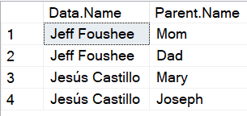
OPENJSON WITH() + CROSS APPLY (vs. JSON array/object)
DECLARE @_json varchar(8000) = '
[{
"name":"Jeff Foushee"
, "parents":[{"name":"Mom"},{"name":"Dad"}]
, "json_expert":false
},
{
"name":"Jesús Castillo"
, "parents":[{"name":"Mary"},{"name":"Joseph"}]
, "json_expert":true
}]'
SELECT
[Data].[name] AS [Data.Name]
, Parent.[name] AS [Parent.Name]
FROM OPENJSON (@_json)
WITH (
[name] varchar(255)
, parents varchar(max) AS JSON
, json_expert bit
) AS [Data]
CROSS APPLY
OPENJSON ([Data].parents)
WITH (
[name] varchar(255)
) AS Parent
Notes:
Using the WITH() clause, I lose the keys’ names in the data.
This is because the key names (as data) were pivoted into column names.

Slide 70
Creating JSON
T-SQL keywords | SELECT / WHERE | FROM / APPLY / JOIN | (Other)
JSON_OBJECT() | þ
JSON_OBJECTAGG() | þ
JSON_ARRAY() | þ
JSON_ARRAYAGG() | þ
FOR JSON AUTO |  |  | þ
FOR JSON PATH |  |  | þ
JSON_MODIFY() | þ
.modify() | þ

Slide 71
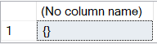
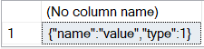
JSON_OBJECT( (key_name : valid_json,)^{1...n}
[, null_clause = NULL ON NULL] )
Generates a JSON object
SELECT JSON_OBJECT()
SELECT JSON_OBJECT('name':'value', 'type':1)
SQL Server 2022+
Azure SQL Database
Azure SQL Managed Instance
Notes:
JSON_OBJECT can be nested, can be combined with JSON_ARRAY which we will discuss soon

Slide 72
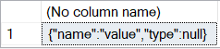
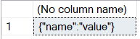
JSON_OBJECT( (key_name : valid_json)^{1...n}
[, null_clause = NULL ON NULL] )
Generates a JSON object
SELECT JSON_OBJECT('name':'value', 'type':NULL)
SELECT JSON_OBJECT('name':'value', 'type':NULL ABSENT ON NULL)
NULL ON NULL)
SQL Server 2022+
Azure SQL Database
Azure SQL Managed Instance
Notes:
JSON_OBJECT can be nested, can be combined with JSON_ARRAY which we will discuss soon

Slide 73
Time for a level-set….
(level set)

Slide 74

Time for a level-set….
(level set)

Slide 75
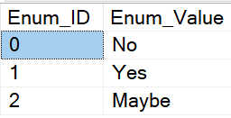
The lessor-known VALUES() table
SELECT 0 AS Enum_ID
, 'No' AS Enum_Value
UNION ALL
SELECT 1, 'Yes'
UNION ALL
SELECT 2, 'Maybe'
SELECT *
FROM (
VALUES(0, 'No')
, (1, 'Yes')
, (2, 'Maybe')
) AS t(Enum_ID, Enum_Value)
Notes:
Here I’m showing a temp table being built with just the VALUES clause. It is statement-scoped.

Slide 76
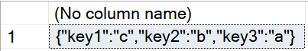
JSON_OBJECTAGG( key_column : value_column null_clause)
Constructs a JSON object from an aggregation of SQL data or columns.
New for SQL Azure/2025!
SELECT JSON_OBJECT('key1':'c', 'key2':'b', 'key3':'a')
SELECT JSON_OBJECTAGG( c1 : c2 )
FROM (
VALUES('key1','c')
, ('key2','b')
, ('key3','a')
) AS t(c1, c2);
SQL Server 2025+
Azure SQL Database
Azure SQL Managed Instance
Notes:
I can mimic the JSON_OBJECT function with JSON_OBJECTAGG…

Slide 77
JSON_OBJECTAGG( key_column : value_column null_clause)
Constructs a JSON object from an aggregation of SQL data or columns.
SELECT DB_NAME(DB_ID()) AS [DatabaseName]
, SCHEMA_NAME(t.[schema_id]) AS [SchemaName]
, t.[name] AS [TableName]
, JSON_OBJECTAGG( c.[name] : x.[name] ) AS [Columns_json]
FROM sys.tables t
INNER JOIN sys.columns c
ON t.[object_id] = c.[object_id]
INNER JOIN sys.types x
ON c.user_type_id = x.user_type_id
GROUP BY SCHEMA_NAME(t.[schema_id]), t.[name]
ORDER BY SCHEMA_NAME(t.[schema_id]), t.[name]
An object of key:value pairs
Notes:
… but the value-add comes from using a GROUP BY clause to combine any two columns of an existing table and enclosing them into an object of key/value pairs

Slide 78


JSON_ARRAY( [valid_json,] ^{1...n}
[, null_clause = ABSENT ON NULL] )
Generates a JSON array given a list of valid JSON
SELECT JSON_ARRAY()
SELECT JSON_ARRAY('a', 1, 'b', 2)
SQL Server 2022+
Azure SQL Database
Azure SQL Managed Instance
Notes:
JSON_ARRAY can be nested, can be combined with JSON_OBJECT.
Notice the defaults of ABSENT ON NULL and NULL ON NULL switch between the two

Slide 79


JSON_ARRAY( [valid_json,] ^{1...n}
[, null_clause = ABSENT ON NULL] )
Generates a JSON array given a list of valid JSON
SELECT JSON_ARRAY('a', 1, 'b', NULL)
SELECT JSON_ARRAY('a', 1, 'b', NULL NULL ON NULL)
ABSENT ON NULL)
SQL Server 2022+
Azure SQL Database
Azure SQL Managed Instance
Notes:
JSON_ARRAY can be nested, can be combined with JSON_OBJECT.
Notice the defaults of ABSENT ON NULL and NULL ON NULL switch between the two

Slide 80

JSON_ARRAYAGG( column [ORDER BY some_column] )
Constructs a JSON array from an aggregation of SQL data or columns
New for SQL Azure/2025!
SELECT JSON_ARRAY('a', '1', 'b', '2')
SELECT JSON_ARRAYAGG( c1 )
FROM (
VALUES ('a'), ('1'), ('b'), ('2')
) AS t(c1)
SQL Server 2025+
Azure SQL Database
Azure SQL Managed Instance
Notes:
I can mimic the behavior of JSON_ARRAY using JSON_ARRAYAGG.
However, just like any physical table, the values have to agree in datatype.

Slide 81
JSON_ARRAYAGG( column [ORDER BY some_column] )
Constructs a JSON array from an aggregation of SQL data or columns
SELECT DB_NAME(DB_ID()) AS [DatabaseName]
, SCHEMA_NAME(t.[schema_id]) AS [SchemaName]
, t.[name] AS [TableName]
, JSON_ARRAYAGG( c.[name] ORDER BY c.[name] ) AS [ColumnNames_Array]
FROM sys.tables t
INNER JOIN sys.columns c
ON t.[object_id] = c.[object_id]
GROUP BY SCHEMA_NAME(t.[schema_id]), t.[name]
ORDER BY SCHEMA_NAME(t.[schema_id]), t.[name]
Notes:
The value-add of JSON_ARRAYAGG is using a GROUP BY clause to consolidate values into a potentially-ordered array.

Slide 82
SELECT … FOR JSON AUTO
Formats the ENTIRE resultset as one JSON object.
SELECT *
FROM
( SELECT 'Jeff Foushee' AS 'name'
, 0 AS 'json_expert'
, NULL AS AllTime_Jeopardy_Winnings
UNION ALL
SELECT 'Jesús Castillo' AS 'name'
, 1 AS 'json_expert'
, '$1.00' AS AllTime_Jeopardy_Winnings
) a
FOR JSON AUTO
SQL Server 2016+
Azure SQL Database
Azure SQL Managed Instance
Azure Synapse Analytics

Slide 83
SELECT … FOR JSON AUTO
Formats the ENTIRE resultset as one JSON object.
Notes:
It should be noted that the display in the FOR JSON AUTO is not necessarily pretty-printed JSON.
You would still need Notepad++ or some other 3rd-party tool.
(I have a demo showing that you only receive pretty-print output if it was initially inserted in pretty-print format.)

Slide 84

Notes:
Earlier we talked about how many characters to show in the Query Results pane. It said “Non-XML data”

Slide 85

Notes:
But here, this is considered “XML data.” The default is 2MB, and I can go higher.
Remember the limit for “Non-XML data” is 2MB.
2MB is roughly 2097152 characters (if varchar), so don’t go overboard.
SSMS aims to please at the expense of your RAM.

Slide 86

SELECT … FOR JSON AUTO
Formats the ENTIRE resultset as one JSON object. Can be used to view original/entire JSON.
SELECT [ArbitraryID], [LongJson]
FROM [JsonDemo].[dbo].[Table_1]
WHERE ...
SELECT JSON_QUERY(LongJson, '$') AS [value]
FROM [JsonDemo].[dbo].[Table_1]
WHERE ...
FOR JSON AUTO
https://microsoftedge.github.io/Demos/json-dummy-data/
Notes:
This means I can get around the limit of 65K characters in GridView by re-casting the JSON as “FOR JSON AUTO” to view untruncated in an XML window.

Slide 87
Demo time…
FOR JSON AUTO

Slide 88
SELECT … FOR JSON PATH
Also formats the ENTIRE resultset as one JSON object.
Allows for greater flexibility and control in your JSON object definition.
[
{
"AlsoEligible": [
{
"json_expert": 0,
"name": "Jeff Foushee"
}
],
"Contestants": [
{
"AllTime_Jeopardy_Winnings": "$1.00",
"json_expert": 1,
"name": "Jesús Castillo"
}
]
}
]
SELECT
( SELECT 'Jesús Castillo' AS 'name'
, 1 AS 'json_expert'
, '$1.00' AS AllTime_Jeopardy_Winnings
FOR JSON PATH
) AS Contestants
, ( SELECT 'Jeff Foushee' AS 'name'
, 0 AS 'json_expert'
, NULL AS AllTime_Jeopardy_Winnings
FOR JSON PATH
) AS AlsoEligible
FOR JSON PATH
SQL Server 2016+
Azure SQL Database
Azure SQL Managed Instance
Azure Synapse Analytics
Notes:
Notice how Jeff’s “AllTime_Jeopardy_Winnings” value disappeared because it is NULL.
This is the default behavior of FOR JSON (AUTO|PATH). See next slide for options to include it anyways.

Slide 89



SELECT … FOR JSON (AUTO|PATH)
Additional options:
FOR JSON (AUTO|PATH), INCLUDE_NULL_VALUES
Includes null values in the FOR JSON output. The default is to exclude
keys with null values (think “ABSENT ON NULL”).
FOR JSON (AUTO|PATH), ROOT('rootname')
Generates an additional outer JSON object with a solitary property named
“rootname” and a value that embodies all the FOR JSON results
FOR JSON (AUTO|PATH), WITHOUT_ARRAY_WRAPPER
Removes the outermost array brackets [] of the FOR JSON results

Slide 90
JSON_MODIFY(valid_json, path, new_value)
Alters the properties inside a JSON object
DECLARE @_json varchar(8000) = '
{
"name":"Jeff Foushee"
, "parents":[{"name":"Mom"},{"name":"Dad"}]
, "json_expert":false
}'
-- Batch 1
SELECT JSON_MODIFY(@_json, '$.name', 'Jeff')
-- Batch 2
SET @_json = JSON_MODIFY(@_json, '$.name', 'Jeff')
SELECT @_json
-- Batch 3
UPDATE dbo.Table1
SET json_col = JSON_MODIFY(json_col, '$.name', 'Jeff')
SQL Server 2016+
Azure SQL Database
Azure SQL Managed Instance
Azure Synapse Analytics
Notes:
The first statement modifies the JSON, but only for the scope of the statement.
The second pair of statements persist the change.
Notice in the third statement that I don’t have to update the entire JSON for just a single value

Slide 91
JSON_MODIFY(valid_json, path, new_value)
Alters the properties inside a JSON object
DECLARE @_json varchar(8000) = '
{
"name":"Jeff Foushee"
, "parents":[{"name":"Mom"},{"name":"Dad"}]
, "json_expert":false
}'
SELECT JSON_MODIFY(@_json, '$.dog', '1')
SELECT JSON_MODIFY(@_json, 'lax $.dog', '1')
SELECT JSON_MODIFY(@_json, 'strict $.dog', '1')
Property cannot be found on the specified JSON path.
SELECT JSON_MODIFY(@_json, 'strict $.json_expert', null)
SELECT JSON_MODIFY(@_json, '$.json_expert', null)
SELECT JSON_MODIFY(@_json, 'lax $.json_expert', null)
-- Adds/sets even if non-existent
-- Sets, only if pre-exists
-- Explicitly sets to null
-- Removes from JSON doc
Notes:
Or friends “lax” and “strict” are extremely important when it comes to deleting or dropping values from JSON

Slide 92

<jsontype_column>.modify
New for SQL Server 2025!
The “preferred” way to modify a JSON document in a json type column
Contains optimizations to perform in-place modifications to the data where possible
CREATE TABLE #temp
(ArbitraryID int NOT NULL, jsonData json NOT NULL)
INSERT INTO #temp (ArbitraryID, jsonData)
VALUES (1, '{
"name":"Jeff Foushee"
, "parents":[{"name":"Mom"},{"name":"Dad"}]
}')
UPDATE #temp
SET jsonData.modify('$.name', 'Jeff')
WHERE ArbitraryID = 1;
https://learn.microsoft.com/en-us/sql/t-sql/data-types/json-data-type

Slide 93
Where do we go from here?
Learned about the JSON datatype
Learned all the JSON operators:
Learned about CROSS APPLY, in conjunction with OPENJSON()
Learned how to review “all the JSON” inside SQL Management Studio
ISJSON() JSON_ARRAY() JSON_ARRAYAGG() (SQL Azure/2025+) JSON_CONTAINS() (SQL 2025+) JSON_MODIFY() - “.modify” (SQL 2025+) JSON_OBJECT() | JSON_OBJECTAGG() (SQL Azure/2025+) JSON_PATH_EXISTS() JSON_QUERY() (SQL Azure/2025+) JSON_VALUE() OPENJSON() ± WITH() SELECT … FOR JSON AUTO SELECT … FOR JSON PATH

Slide 95

Notes:
Even Jason is happy!

Slide 96
Notes:
But we’d be pressing our luck to convince him on the benefits of relational

Slide 97


Slide 98

Jeff Foushee
Safe travels home!
linkedin.com/in/jeff-foushee/
github.com/jbfoushee/MyPresentations
jefffoushee.com

